Slide 1
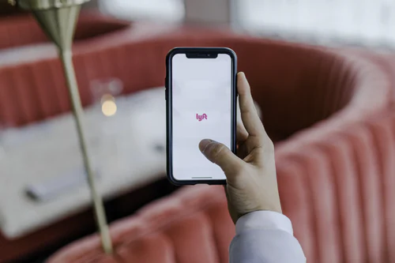
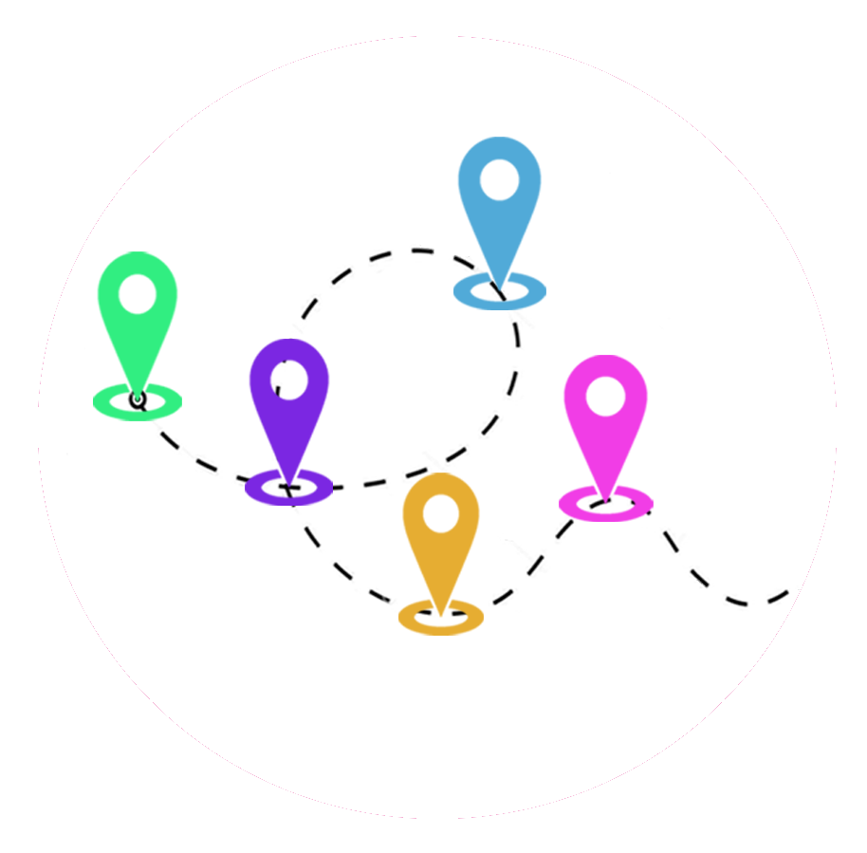

PRESENTATION TRAV'HELP
Karla FLATRES
Marc-Antoine HERVE
Pierre LELIEVRE
Robinson MATHIEU
Quentin ROCHA PINTO
Diego SANCHEZ
PPE Team #1970

Slide 2

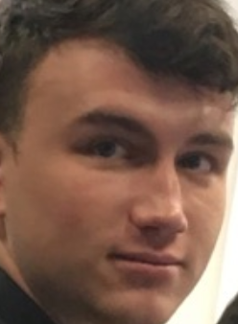
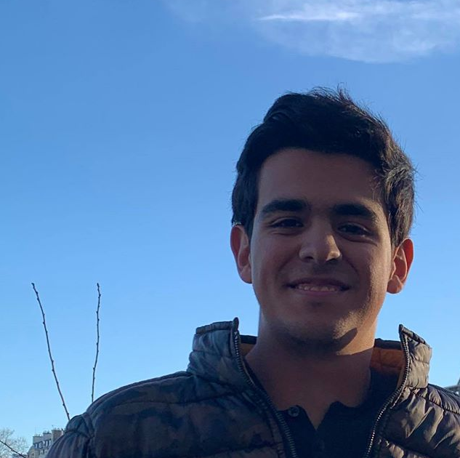
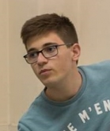
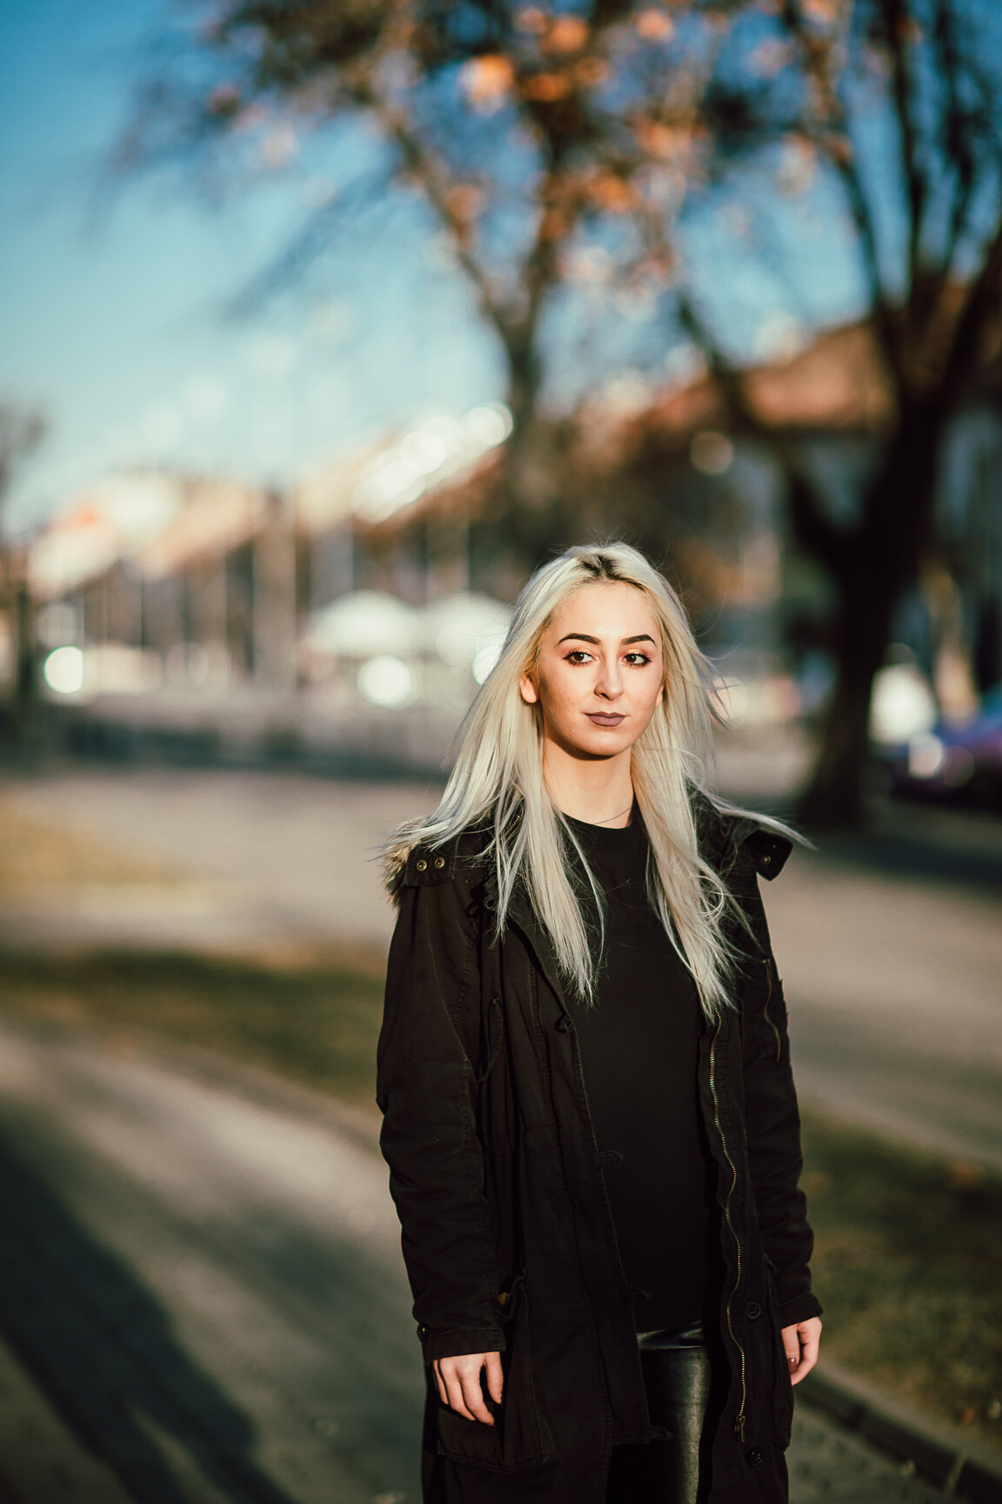
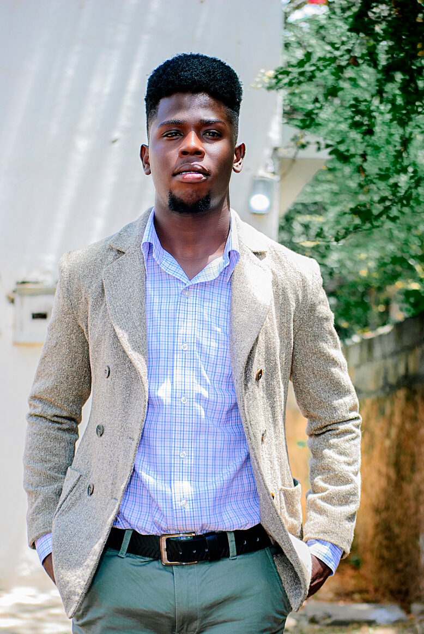
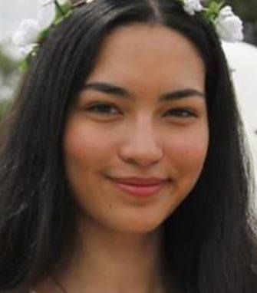
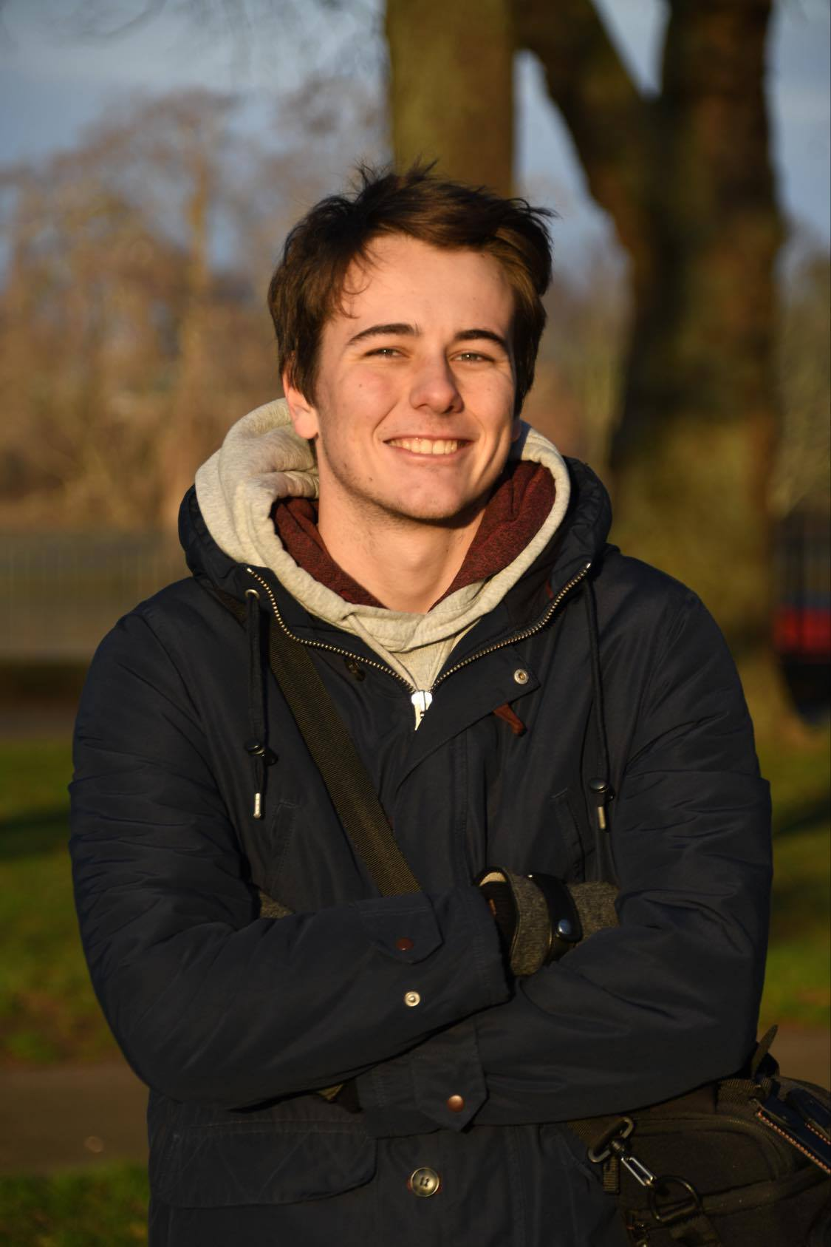
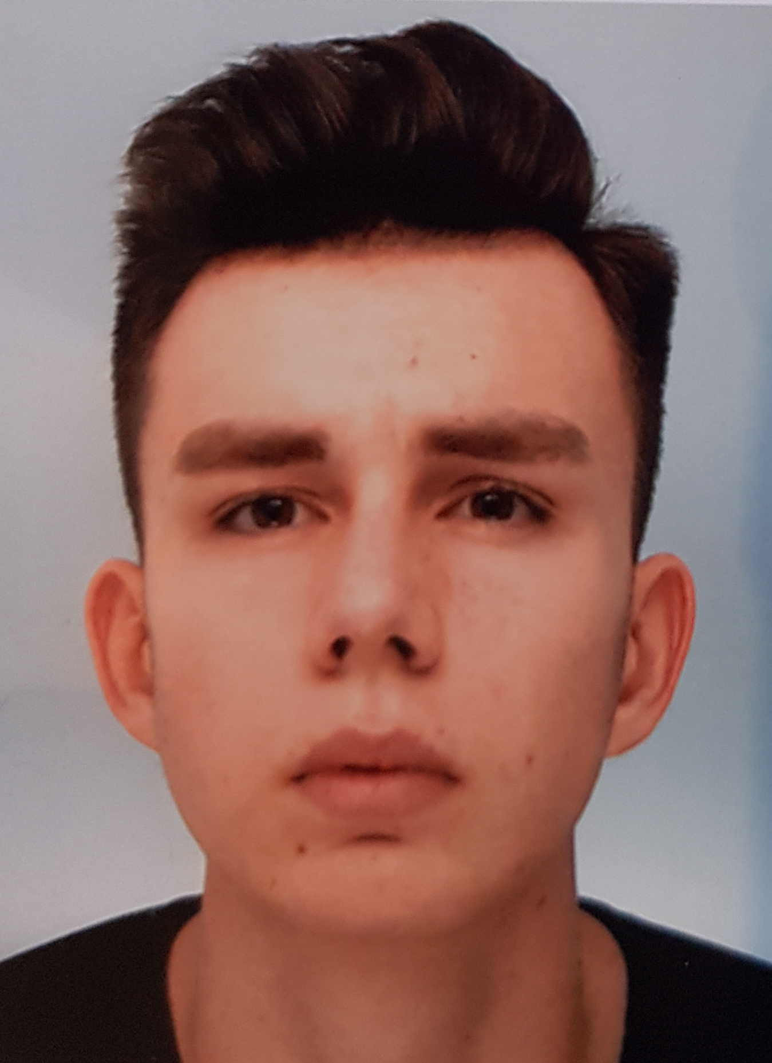
THE TEAM
Quentin Rocha-Pinto
Diego Sanchez
Pierre Lelièvre
Algorithm / Application Code
Valorisation / Server
Project Manager /
Every field of the project
Karla Flatres
Marc-Antoine Hervé
Robinson
Mathieu
Valorisation / Documentation
Algorithm / Documentation
Algorithm / Application Code
2
Notes:
okii
DIego arrive normalement:)

Slide 3
1
1
Introduction - Objectives
Summary
2
The Solution we propose
3
Conclusion -
Future of the Project
3
Notes:
je dec karlouche

Slide 4

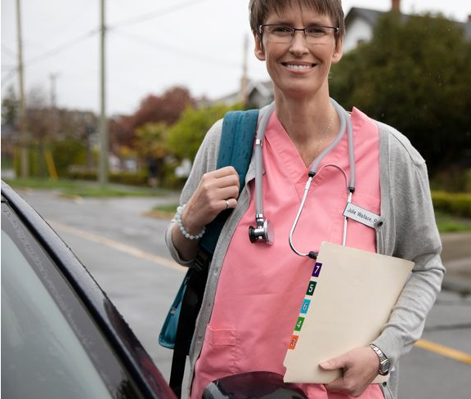
Introduction
A liberal nurse:
Visits 25 to 30 patients within 6 hours
Drives for about 150 km
Driving accounts for roughly 30% of her time
4

Slide 5

Problem :
How to give liberals more time ?
5

Slide 6
OUR OBJECTIVES
IMPLEMENT OUR OWN ALGORITHM
OPTIMIZE LIBERALS' SCHEDULE
TURN IT INTO AN APPLICATION
6

Slide 7
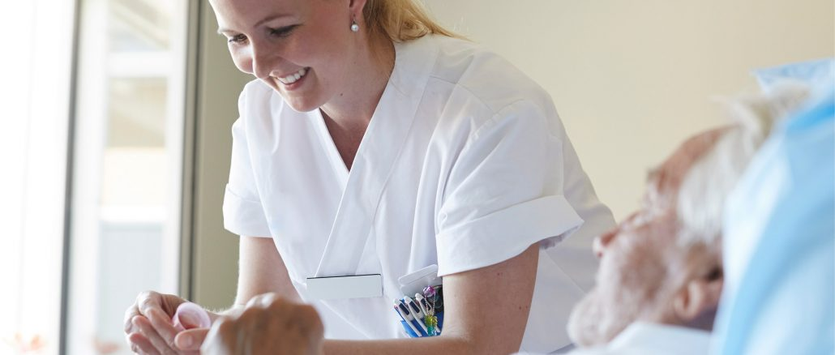
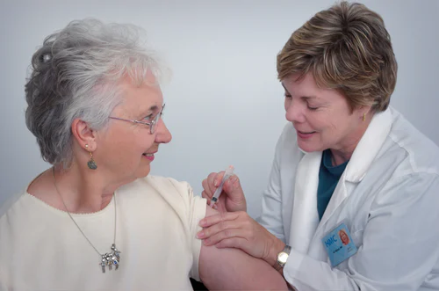
People affected
by our work
LIBERAL PROFESSIONS
CLIENTS AND PATIENTS
ENVIRONMENT
7
Notes:
qui es tu pigeon anonyme ?

Slide 8
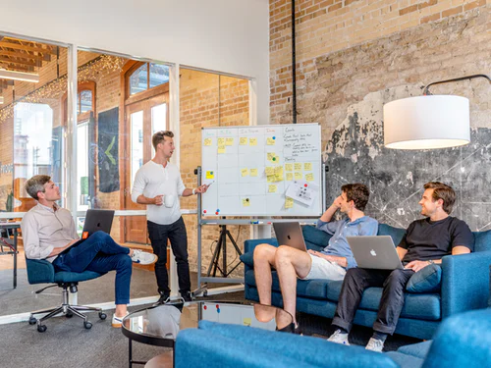
The solution we propose
8

Slide 9
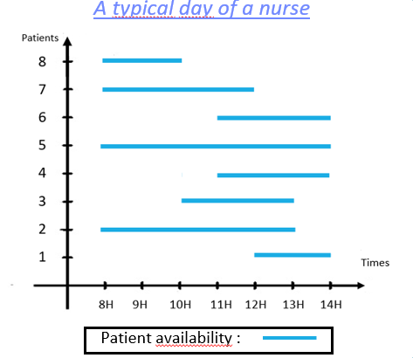
An algorithm solving the Traveling Salesman Problem with Time Windows
9

Slide 10

METHODOLOGY
Data analysis
and time interval creation
STEP 1
Picking best route possible
LEADING TO
An exact solution
STEP 2
Recurrence until last intervall
STEP 3
10

Slide 11
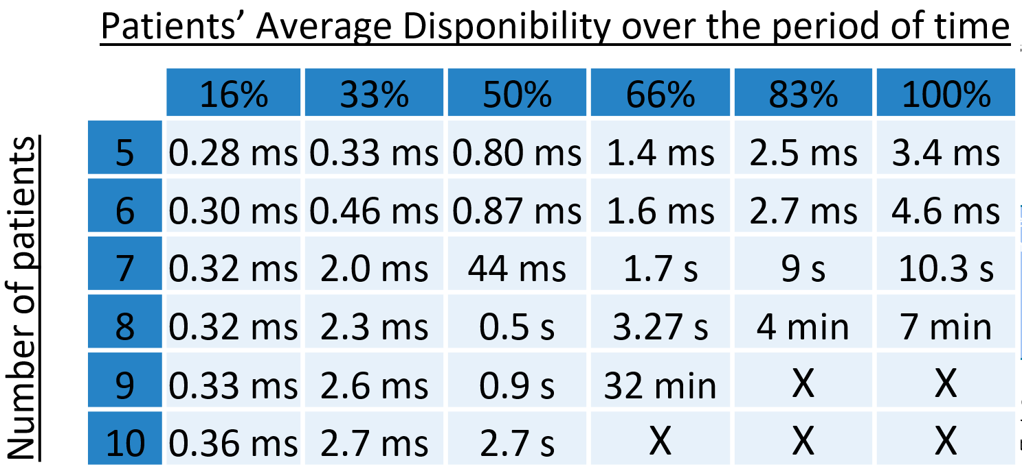

TESTS RUN
11

Slide 12
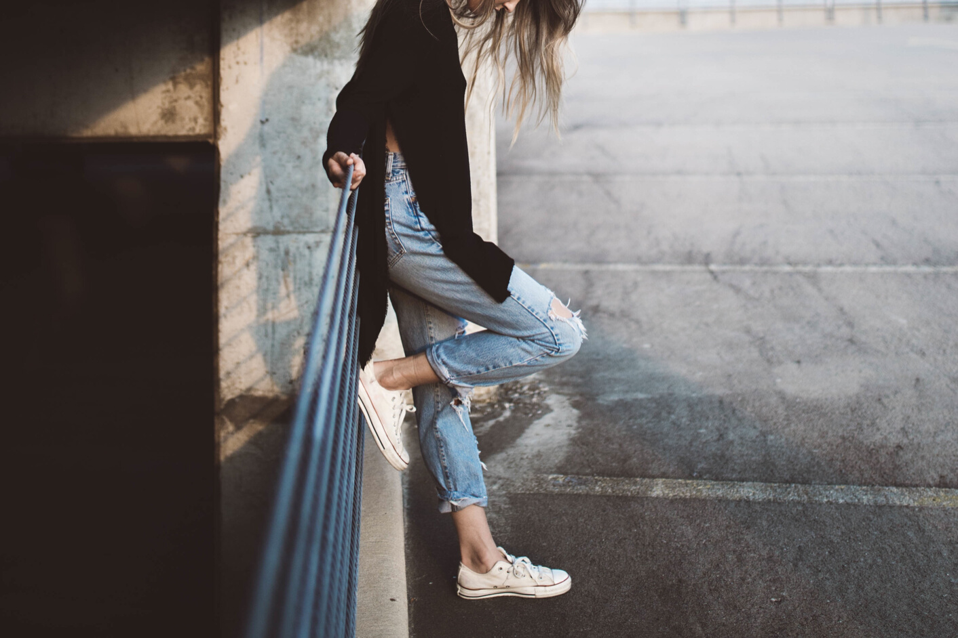
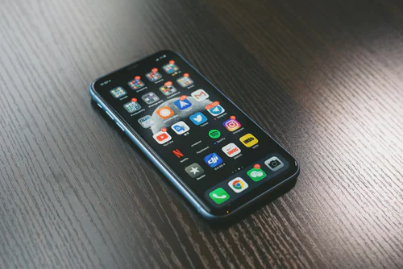


TRAV'HELP
Mobile Application
Android application
Database & Server in NodeJS
Computations in Python
Distances from Google API
12

Slide 13


Functions
Optimize a time table for each patient and their needs
Find and show the user the fastest route to reach patients
.
Store your patients' data online
13

Slide 14
CONCLUSION
14

Slide 15
Tasks recap
Theorizing an algorithm
Implementing it
Creating an architecture exploiting this algorithm
server-side
front-side
15

Slide 16


TECHNICAL DIFFICULTIES
COMMUNICATION SKILLS
TRAV'HELP
Developed our adaptability and ability to learn new technologies
Forced us to develop a good internal communication, allowing rapid and balanced advance of the project
FIRST BIG
PROJECT
Multidisciplinary project, full touch of our major differences
Group work, equitable distribution of tasks adapted to each profile
DIFFICULTIES
&
WHAT IT TAUGHT US
16
Notes:
wtf les numeros de diapo en milieu de page XDD mdddr j'avoue wtf ces trucs

Slide 17

ON THE ALGORITHM
Optimize further its implementation to be faster and more efficient
GOALS FOR
THE FUTURE
ON THE APPLICATION
Finalize its first version : distances and UI
Add new features
COMMERCIAL APPROACH
Present our work to liberals' representatives
Let it be known by more people
Customize our solution according to their needs
17

Slide 18
THANK YOU
FOR YOUR ATTENTION !
18

